Slide 1
DOM Instrumentation to Display Provenance Data
Jayen Gulab
Supervisor: Jens Dietrich

Slide 2

Introduction and Motivation
Companies must comply with data protection standards defined by the GDPR.
Project aimed to provide transparency to end-users regarding how their data is utilised by server-side applications.
Three approaches were explored.

Slide 3
Use Case
Kathy searches for car insurance, and wants to know whether her data was shared with a third party, or stored, and whether some AI with a potential bias was used to process her request

Slide 4
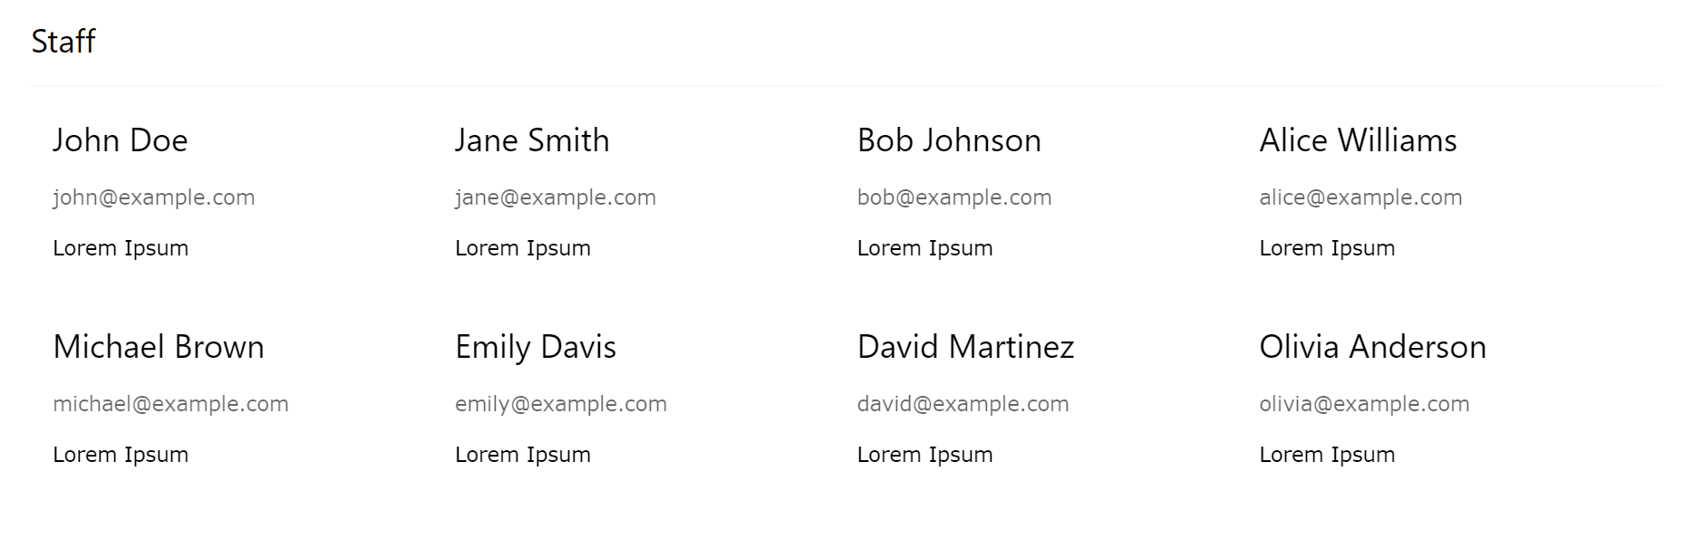
Before Instrumentation

Slide 5
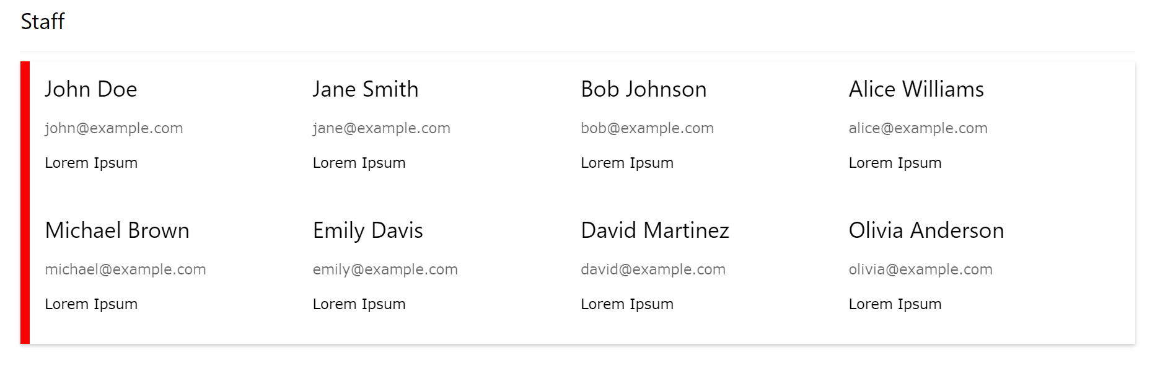
After Instrumentation

Slide 6
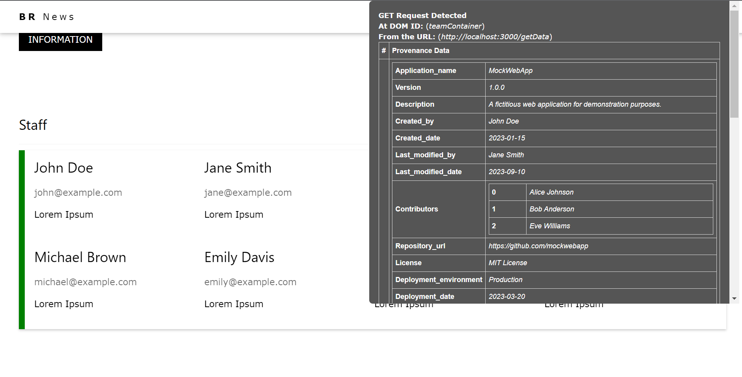
After Instrumentation with Popup

Slide 7
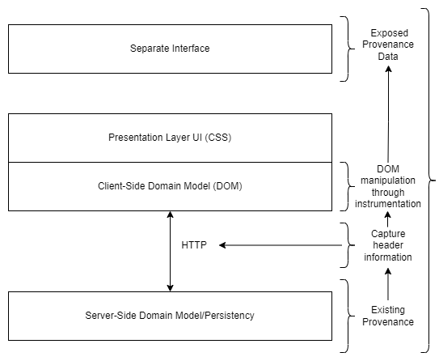
Design and Approaches
The Document Object Model (DOM) is an interface standardised by the W3C that treats HTML documents as a tree structure
Data provenance documents the origin, history, and transformations of data, increasing transparency for end-users
Software instrumentation is a technique that is used in software profiling, performance analysis, optimisation, testing, and error detection

Slide 8
Justification of Chosen Approach
Selection of JavaScript instrumentation was driven by its code readability and ease of understanding.
The chosen approach offers flexibility
The code exhibits low coupling
All the code was deliberately consolidated into a single file for simplicity and user-friendliness.

Slide 9
Technical Discussion of Solution
The implementation consists of two core components: "instrument.js" for program logic and "popup.css" for styling the provenance pop-up.
The program uses a MutationObserver API to track DOM changes.
It extends the functionality of XMLHttpRequest and jQuery Ajax requests to capture information.
This implementation serves as a robust system for tracking and presenting provenance data associated with Ajax requests.

Slide 10
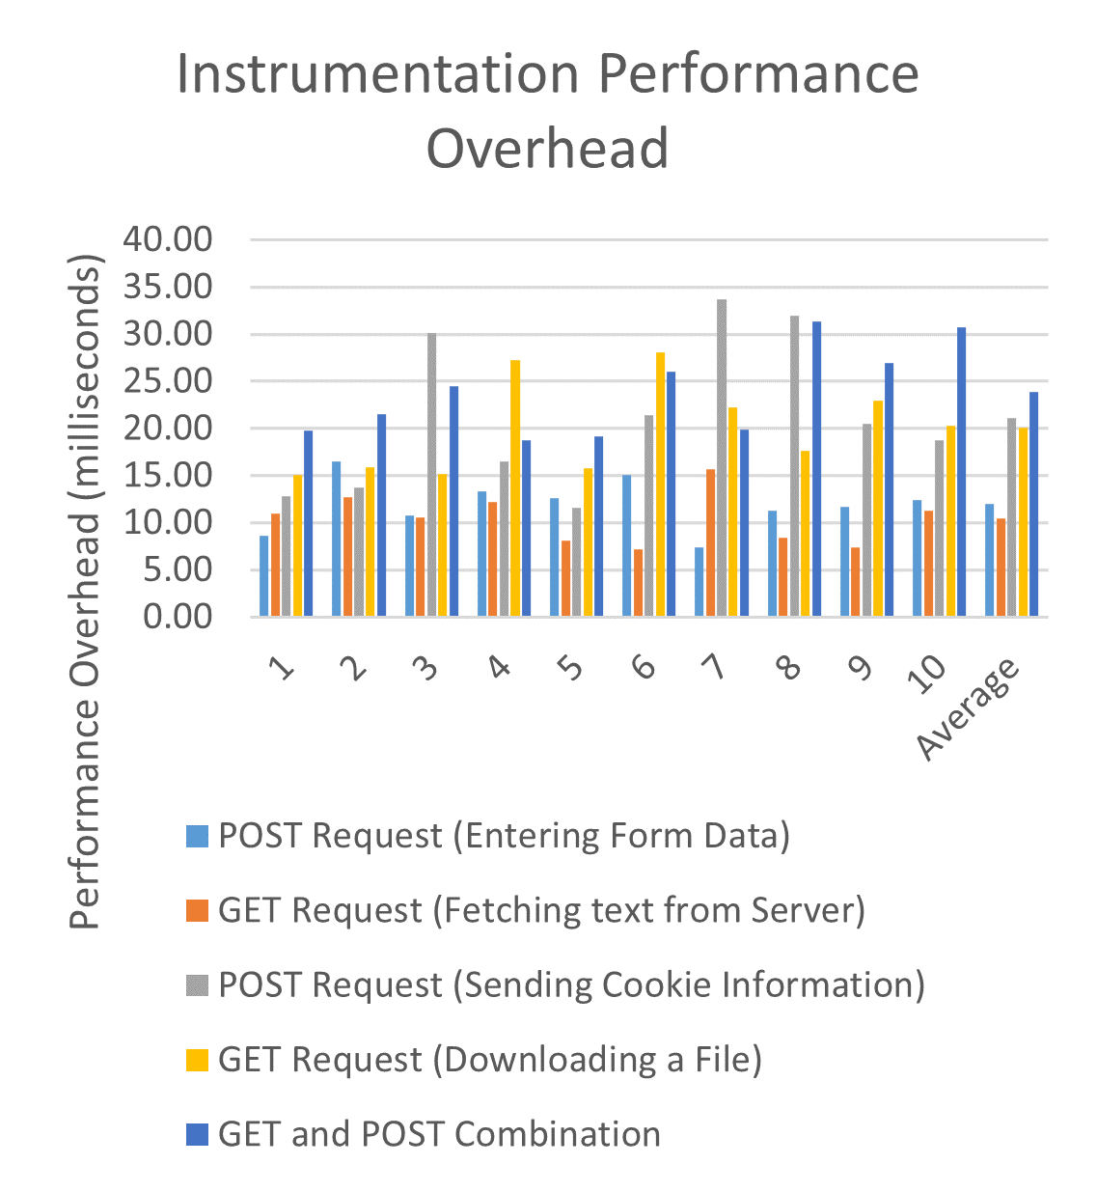
Evaluation and Performance Testing
The Rational Unified Process (RUP) was employed
Performance testing was conducted on a mock webpage using the Chrome performance tools.
User-friendliness and performance optimisation were prioritised.

Slide 11
Conclusion
Project aimed to enhance transparency of user data in web applications.
It focused on developing software solutions to instrument the DOM
Quality evaluation criteria included runtime overhead, installation complexity, development costs, and alignment with project requirements
Future work includes integration with Server-Side Provenance software.

